Slide 1
Southern Water Corp – Executive Presentation
Presenter: Danny Hua

Slide 2
Executive Summary
Southern Water corporation is facing an increase in demand, competition, and market supply
the market price is forecast to drop to $53.98/ML
There will be a Huge Maintenance event done on Kootha and Surjek (our oldest plants)
overall rolling cost to produce is expected to increase by $38.01/ML by the end of June 2015
annual ebit is forecast to decline by ~$264 mil

Slide 3

Southern Water Corp is expecting overall rolling cost to produce will increase by $38.01/ML in Jun-2015 compared to prior year
Notes:
- Overall rolling cost-to-produce will increase by $38.01/ML by the end of June 2015, putting it at $71.68
- We can see that cost-to-produce is slowly decreasing after April which is the result of the maintenance event being completed

Slide 4
Cost to produce for Jutik is well under the market price where as the cost to produce for Surjek is $115.33 and is more than double the market price
Pseudo Cost Curve Highlighting Cost to Produce versus Market Price
Least Expensive
Most Expensive
Kootha and Surjek’s cost to produce is above the market price
It is not sustainable to dispatch all of the desalination plants at the same time
If no action is taken, especially to reduce Surjek’s cost-to-produce, then EBIT will be heavily impacted

Slide 5
Operational Expenses have the greatest variance with cost increasing by ~$33/ML. We should pay close attention to Operational Expenses
Key Insights
The huge variance in Operational Expenses is mostly contributed to an increase in Surjek’s expenses
Surjek is also a huge contributor for the increase in overall COGS

Slide 6
Surjek displays the greatest variance in Revenue, COGS, and Operational Expenses
Negative Var.
Positive var.
Actual vs Budget PL variances, YTD, $m
Actual
Forecast
Revenue
Revenue Kootha
101.5
55.3
Revenue Surjek
233.0
124.8
Revenue Jutik
190.2
222.7
COGS
(Production Costs)
Production Cost Kootha
0.6
8.8
Production Cost Surjek
7.1
21.1
Production Cost Jutik
2.2
7.5
Operational Expenses (Overheads)
Overhead Kootha
45.2
65.8
Overhead Surjek
150.5
217.1
Overhead Jutik
45.5
73.3
¹EBIT
273.5
9.3
Notes:
It makes sense for Surjek to have the greatest loss in revenue because Surjek is going from providing 3274.38 GL of water a year in 2013/2014 to just 2,064.70 GL a year for 2014/2015

Slide 7
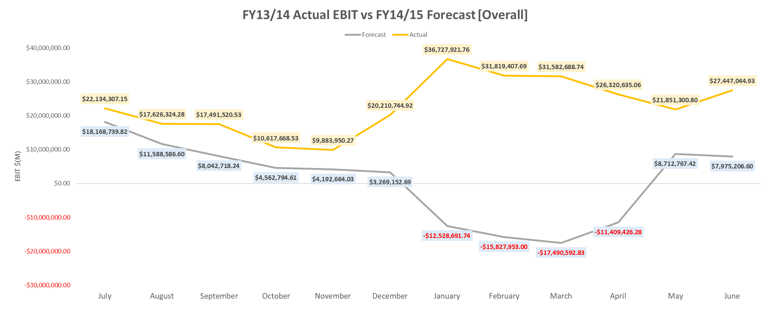
EBIT is forecast to be negative for the month of January through April. We are expecting a ~$264 mil annual decline in EBIT compared to FY13/14
EBIT = Revenue – COGS – Operational Expenses
EBIT is negative for the month of January – April is due to Kootha and Surjek being shut down for maintenance so no revenue will be generated from desalinated water sales
Negative EBIT is also due to the maintenance event which is driving up overheads. The increase in COGS and Operational Expenses with an overall decline in revenue will put EBIT in the negative

Slide 8
Based on forecast, there will be a ~$122 mil decrease in annual revenue
Actual vs Budget PL Revenue Analysis, $m
Key Insights
There is a sharp decline in revenue from Jan - April 2015 due to Kootha and Surjek shutting down for maintenance
Revenue is expected to decline by ~59% between Jan to April
Peak revenue in FY13/14 is between Jan - April, which is when maintenance is being done in FY14/15. At this time only Jutik will be operating

Slide 9
We are expecting an annual increase in COGS by ~$27.7 mil COGS appears to return to a normal range after maintenance has been completed
Actual vs Budget PL COGS Analysis, $m
Key Insights
COGS is increasing across each plants
We see a huge drop in COGS in April, but if we take a closer look at May and June we see a slight uptick which may be a result of the slight increase in revenue in the previous slide

Slide 10
Operational expenses are increasing across all desalination plants Overall annual Operating Expenses are expected to increase by ~53%
Actual vs Budget PL Operational Expenses Analysis, $m
Key Insights
Even after the maintenance event we continue to see a rise in operating expenses
Operational expenses for Surjek was only $6.76 mil in June-2014 but in June-2015 it is expected to be $21.4 mil, which is an increase of about $14.6 mil

Slide 11
Summary / Recommendations
When looking at the variances we noticed that the overall Operating Expenses stood out the most followed by COGS
After doing a deeper dive on those two areas we find that Surjek contributes the most to the rise in costs
It is ideal to scale back on production for Surjek until a lower cost to produce has been achieved in order to keep COGS and Operating Expenses down to mitigate its impact on EBIT. Postponing the maintenance event could be an option.
Since loss of revenue is inevitable due to the maintenance event, if possible, the event should be moved to periods where demands are not as high, because Jan – April is when revenue is at its highest according to FY13/14 data and that is revenue SWC is losing out on
Jutik alone cannot provide enough water to meet rising demand during the maintenance event and SWC will miss out on potential revenue. If delaying maintenance for Kootha is not an issue it should remain running while Surjek should be the first plant to undergo maintenance (assuming that we decide to move forward with the maintenance event). We should keep Kootha in operation since Jutik's cost to produce is below the market price and it creates enough of a buffer to mitigate loss.
Jutik has a max water capacity of 300 GL, which means it can supply up to 300 GL of water a month, but the plant is forecast to operate at an average capacity of ~178 GL per month. We need to make sure that Jutik is operating closer to its max capacity before dispatching Kootha and Surjek. This will help reduce costs especially when cost-to-produce for Kootha and Surjek is greater than the market price, thus minimizing the impact on EBIT

